Slide 1
Stages of Research: Cryptographic Artefacts Concealed in Pictorial Matrices
Team Members:
E. Christo Raymonde
D. Ashwanth Jeyesh
Gowtham G
Arunangshu Mojumder Raatul

Slide 2
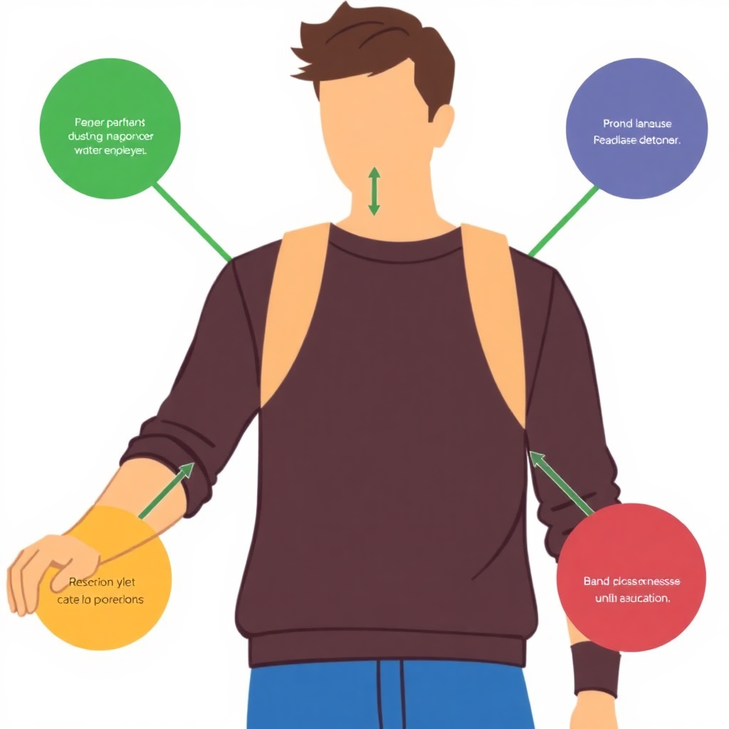
Overview
This project centers on the development and analysis of a novel multi-layer encryption algorithm designed to provide enhanced data security in an increasingly digital world. By employing multiple layers of encryption, the algorithm aims to create a more robust defense against potential cyber threats, ensuring that sensitive information remains protected.
The primary objectives of this research include not only enhancing data security but also exploring innovative encryption techniques and methods. This involves investigating current trends in cryptography, identifying gaps in existing algorithms, and integrating cutting-edge steganographic practices to bolster the overall effectiveness and resilience of the encryption solution.

Slide 3
Key Activities: Conduct a thorough literature review to identify existing gaps in multi-layer encryption techniques and steganography methods. This will involve analyzing recent advancements, assessing the limitations of current algorithms, and pinpointing areas lacking in innovation or efficiency
Research Stage 1: Conceptualization and Literature Review
Goals: Establish a robust theoretical framework for a new encryption algorithm, ensuring it addresses identified gaps. Additionally, integrate this algorithm with steganographic techniques to enhance data security and concealment.
Expected Duration: Allocate 4 to 6 weeks for research, development, and initial testing. This timeline includes formulating the algorithm, integrating steganography elements, and preparing for preliminary validation.

Slide 4
Algorithm Design: Focus on designing multi-layer substitution ciphers that significantly enhance encryption strength by utilizing complex transformations across multiple layers. Each layer will ensure added resilience against cryptographic attacks.
Research Stage 2: Algorithm Design
Ancient Symbol Mapping: Develop a unique layer incorporating ancient symbol mapping techniques to introduce additional complexity. This layer will obscure data further, making decryption exceedingly difficult without specific keys.
Expected Duration: Dedicate 3 to 4 weeks to the complete design and development of these encryption layers, ensuring they meet security and efficiency benchmarks while integrating with previous research findings.

Slide 5
Implementation: Code the encryption algorithm, ensuring it operates with high functionality and efficiency across various data types and sizes. Focus on minimizing computational overhead while maintaining security standards.
Research Stage 3: Implementation
Key Management Systems: Develop secure key management systems to protect encryption keys. This includes ensuring proper key generation, storage, and retrieval while optimizing the overall algorithm for performance and reliability.
Expected Duration: Allocate 4 to 6 weeks for coding, testing, and refining the algorithm. This timeline includes addressing performance bottlenecks and securing key management protocols.

Slide 6
Security Analysis: Conduct comprehensive cryptanalysis, including brute force, differential, and linear attacks, to evaluate the algorithm’s strength and resilience against potential vulnerabilities. Ensure that the image quality in steganography remains unaffected during encryption.
Research Stage 4: Security Analysis
Evaluation Tools and Methodologies: Utilize advanced cryptographic testing tools and methodologies to thoroughly assess the algorithm's security. This includes benchmarking performance, verifying encryption consistency, and identifying any exploitable weaknesses.
Expected Duration: Set aside 2 to 3 weeks for this analysis, focusing on identifying security gaps and ensuring the algorithm's robustness under diverse attack scenarios.

Slide 7
Research Stage 5: Application Development
Application Development: Develop prototypes that utilize the algorithm to encrypt historical documents, preserving their integrity while protecting sensitive data. This will demonstrate the algorithm's practical use in fields such as digital archiving and cultural preservation. The procedure would take 9 to 10 weeks.
Educational Tools: Create interactive educational tools and visual aids to demonstrate how the algorithm works. These tools will be designed to help students and researchers understand the intricacies of the encryption and steganography process.
IoT Implementations: Explore applications of the algorithm in Internet of Things (IoT) environments, focusing on securing communications between connected devices and ensuring data integrity in real-time systems.

Slide 8

Performance Evaluation: Conduct benchmarking tests to assess the algorithm’s efficiency, focusing on processing speed, memory usage, and overall system impact. Additionally, evaluate the quality of images after the steganography process to ensure minimal distortion or data loss.
Research Stage 6: Performance Evaluation
Comparative Analysis: Compare the performance metrics of the new algorithm with existing encryption algorithms, highlighting improvements in speed, security, or resource utilization.
Expected Duration: This stage is expected to take 1 to 2 weeks, during which benchmarking and comparative analysis will be performed to gauge the algorithm's real-world efficiency and effectiveness.

Slide 9
Data Analysis and Documentation: Analyze the results obtained from previous research stages to draw comprehensive conclusions about the algorithm’s performance, security, and practicality. This analysis will synthesize findings, providing insights into the algorithm's effectiveness in addressing identified gaps.
Research Stage 7: Data Analysis and Documentation
Research Paper Preparation: Prepare detailed research papers for publication, documenting the methodology, results, and implications of the study. These papers will target academic journals and conferences to share the findings with the broader research community.
Expected Duration: This stage is expected to take 4 to 6 weeks, allowing ample time for thorough analysis, revisions, and the submission process for publication in relevant academic venues.

Slide 10
Dissemination: Actively engage in the journal publication process to share the findings with the academic community, ensuring that the research is peer-reviewed and contributes to the field of encryption and steganography. This will involve selecting suitable journals, preparing manuscripts, and addressing reviewer feedback.
Research Stage 8: Dissemination
Conference Presentations: Present research findings at relevant conferences to reach a broader audience, including researchers, industry professionals, and practitioners. These presentations will facilitate discussions, garner feedback, and foster collaborations within the academic and technological communities.
Expected Duration: This dissemination process will be ongoing, with a concentrated effort in the final 3 to 4 weeks of the research project, ensuring timely sharing of results and engagement with stakeholders in the field.

Slide 11
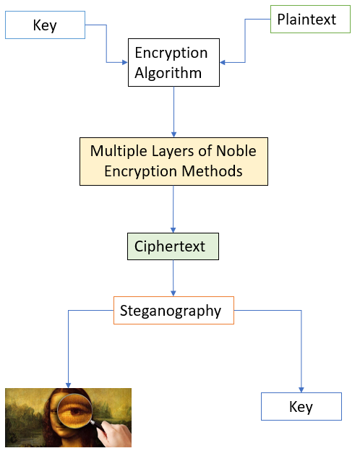
System Overview
The overall system overview of how the system will work.

Slide 12
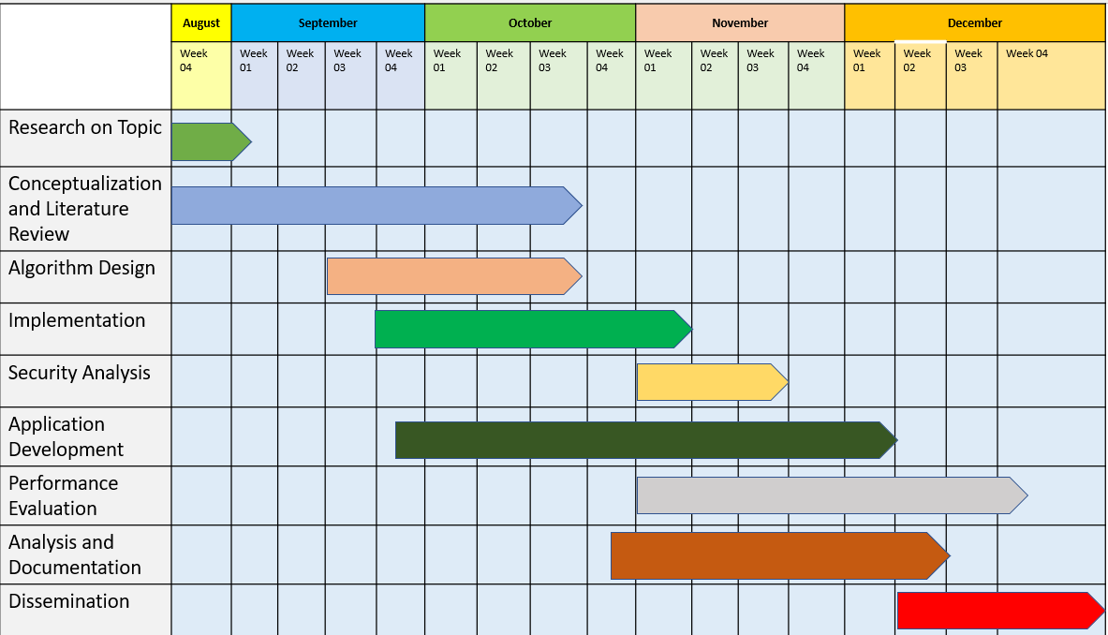
Timeline Overview
A Gantt chart will illustrate the overlapping stages and progress throughout the 17-weeks project duration.

Slide 13

This systematic approach aims to enhance data security by developing an innovative multi-layer encryption algorithm integrated with advanced steganographic techniques. Through a comprehensive literature review, we identified existing gaps in current methodologies, establishing a robust theoretical foundation for our new algorithm.
By addressing the limitations of existing algorithms, the design and implementation phases ensure an efficient and effective solution. Thorough security analysis and performance evaluations confirm the algorithm's reliability, while the development of educational tools and practical applications showcases its versatility.
Overall, the potential impact of this research is significant, paving the way for future innovations in encryption and data protection, and empowering practitioners to safeguard sensitive information in an increasingly interconnected world.
Conclusion

Slide 14
Thank you for your time and attention

